Slide 1
CFO Dashboard - PPT
INTERNAL WITH PII
File created on: 28-10-2025 18:20:01
INTERNAL WITH PII

Slide 2
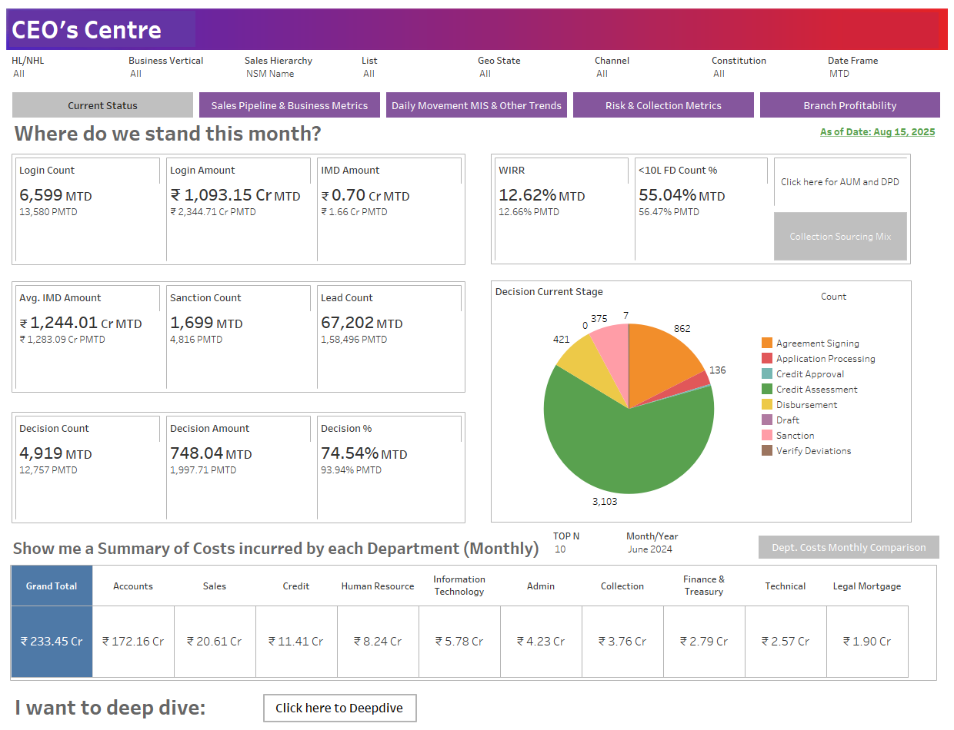
INTERNAL WITH PII
INTERNAL WITH PII

Slide 3
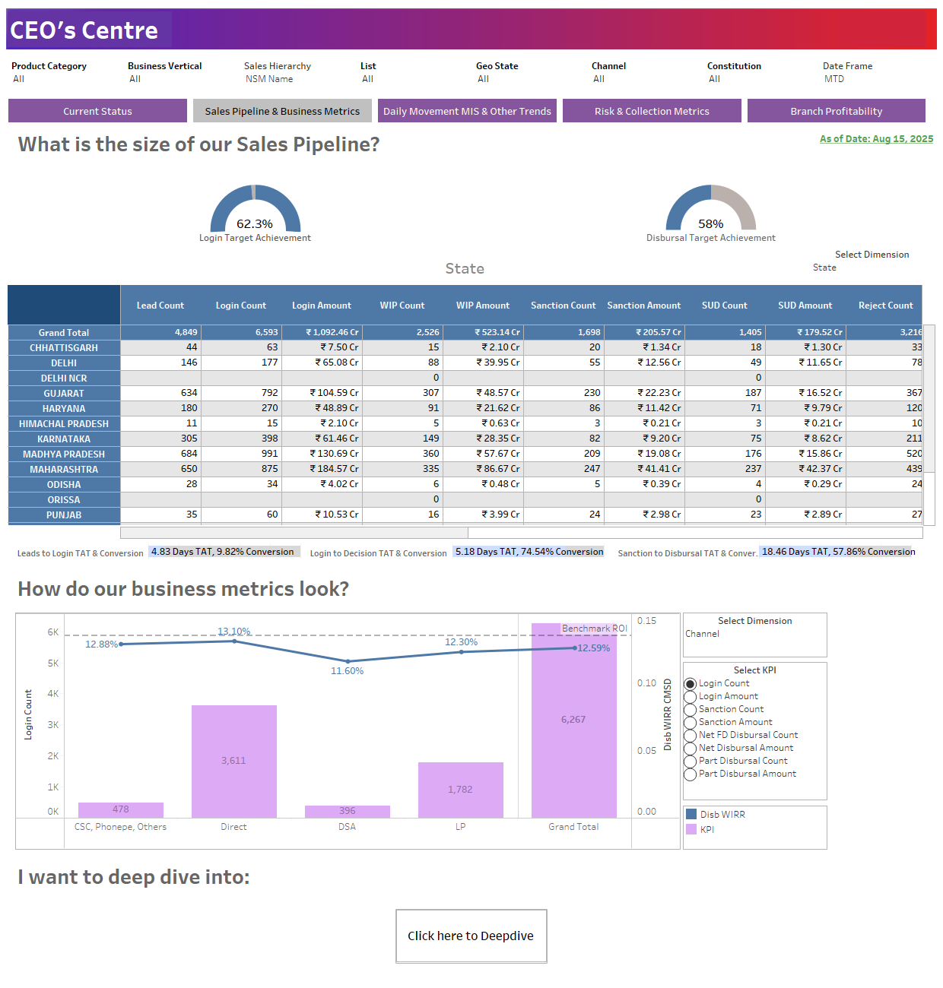
INTERNAL WITH PII
INTERNAL WITH PII

Slide 4
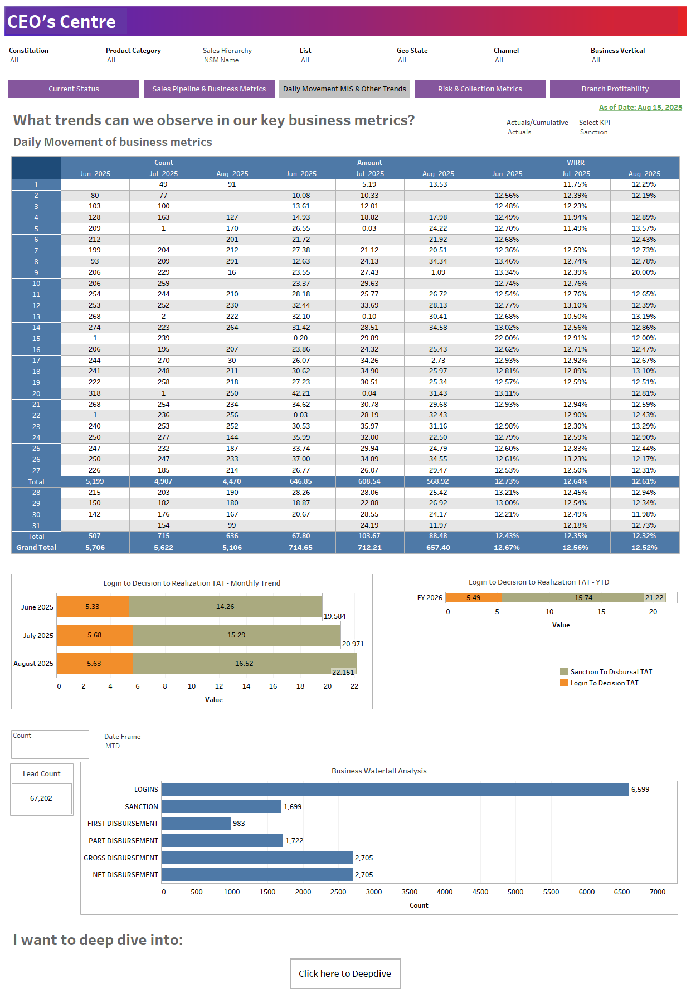
INTERNAL WITH PII
INTERNAL WITH PII

Slide 5
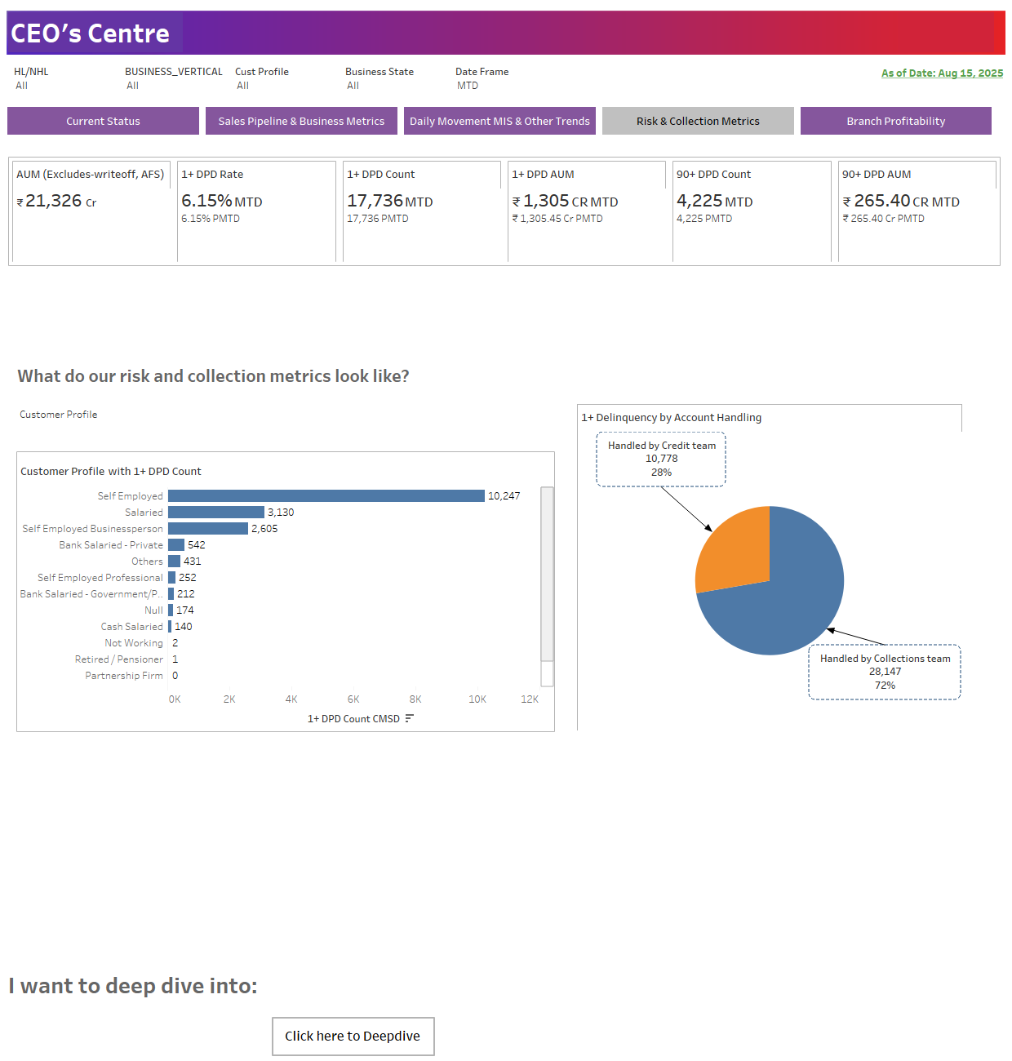
INTERNAL WITH PII
INTERNAL WITH PII

Slide 6
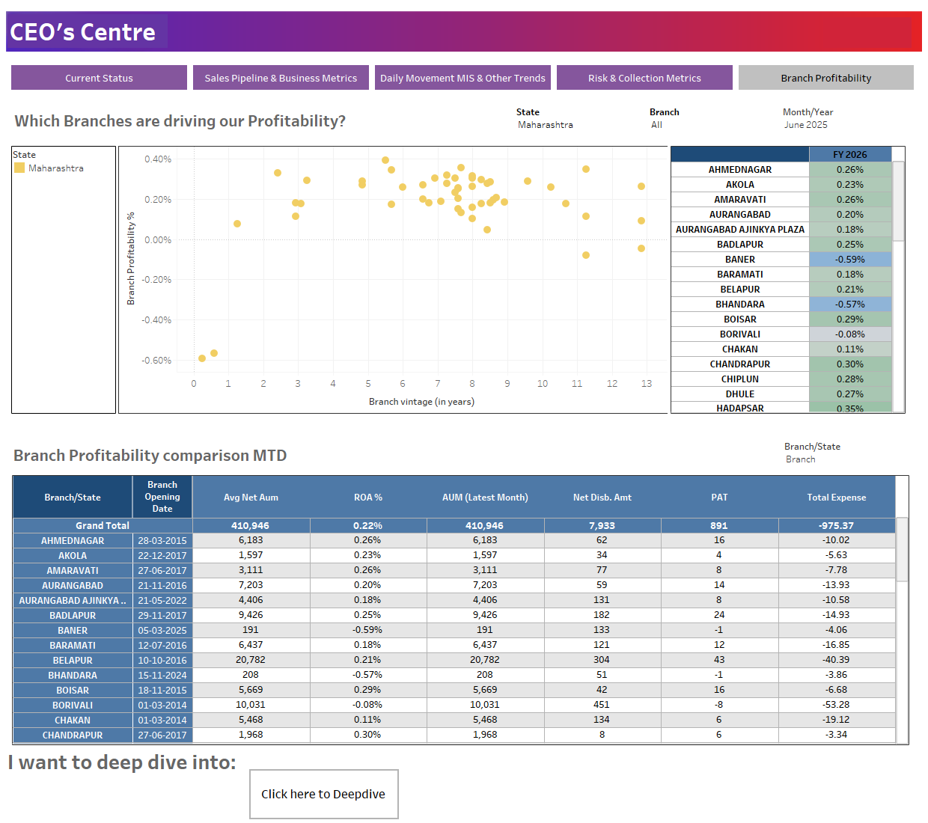
INTERNAL WITH PII
INTERNAL WITH PII

